Slide 1
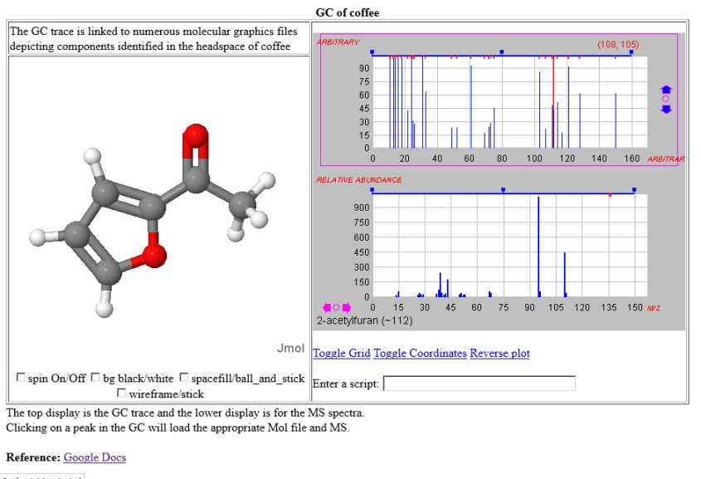
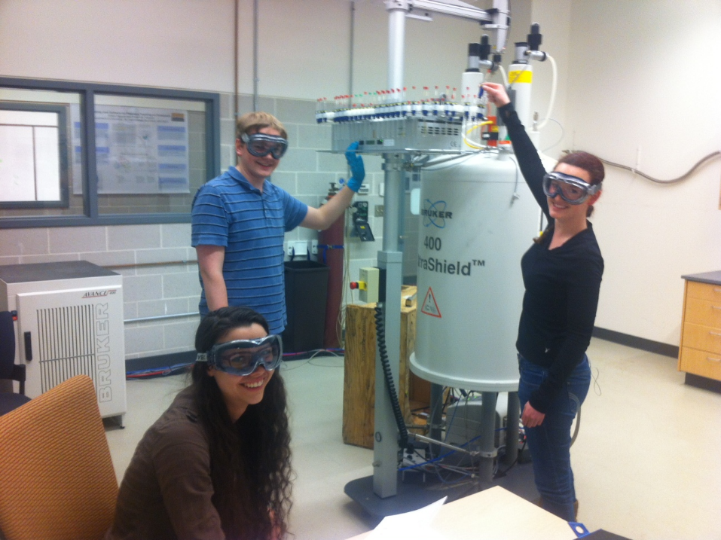
Bob Hanson St. Olaf College Northfield, MN, USA
Integration of Spectroscopy with Molecular Structure:
Recent Advances and Future Plans
Workshop in Cheminformatics
École polytechnique fédérale de Lausanne
30 Aug 2013

Slide 2
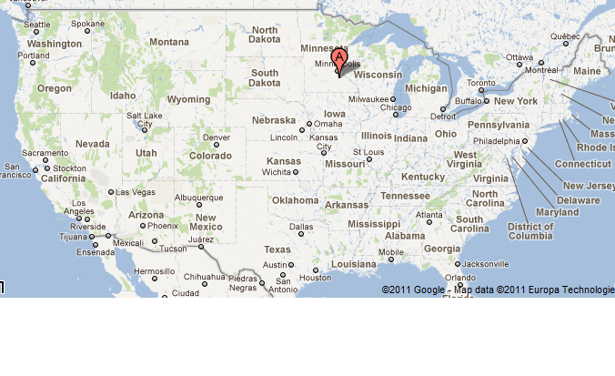

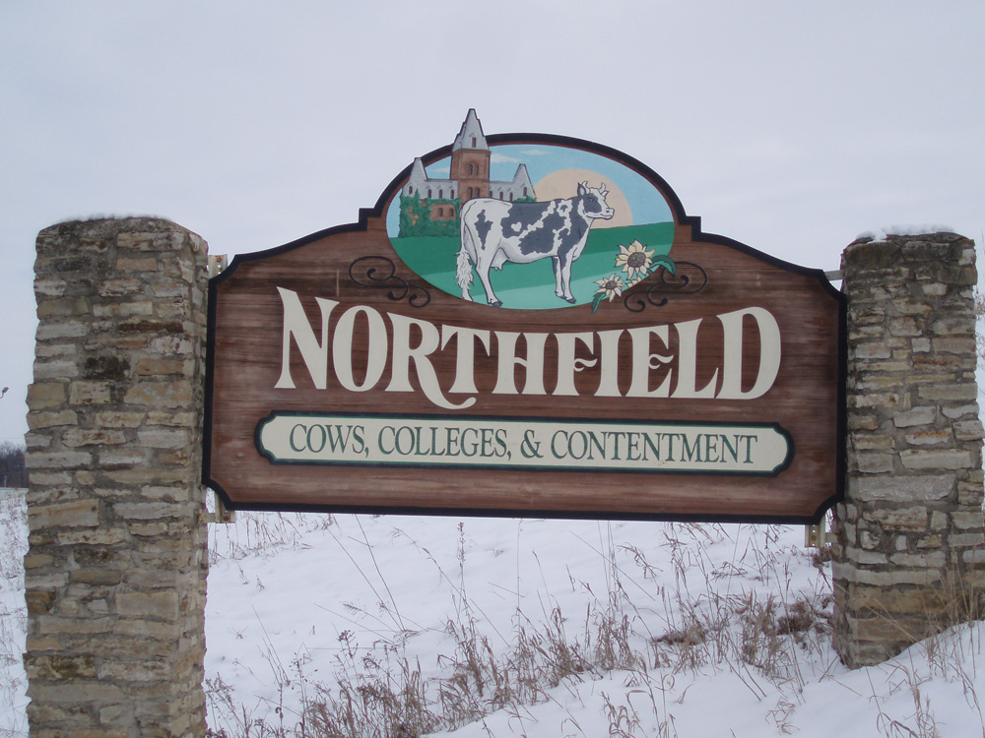
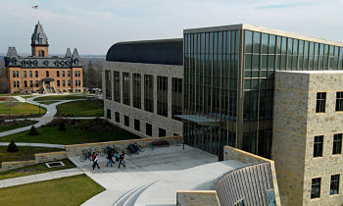

Slide 3
Outline of presentation
Quick overview
The overall goal
Getting there
Work to do

Slide 4
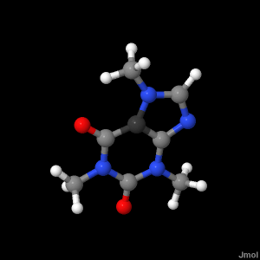
General Introduction to Jmol
Mission: The high-quality, real-time visualization of molecular structure, dynamics, and energetics.
open source Java
cross-disciplinary
development driven by user input

Slide 5
General Introduction to Jmol
small molecules, biomolecules
crystals
-- primitive and conventional unit cells
-- incommensurate modulated structures
-- 3D, 2D, and 1D periodicity
vibrations, symmetry
molecular dynamics trajectories
multiple files and files with multiple structures
MMFF94 and UFF minimization
model building

Slide 6
General Introduction to Jmol
Scripting
Jmol has a rich scripting language that is easily accessed via a console, a pop-up menu, or via an API.
There are nearly 2000 semantic tokens and about 150 commands.
The HELP command accesses the interactive script documentation; VERY active and friendly user group!
http://chemapps.stolaf.edu/jmol/docs

Slide 7
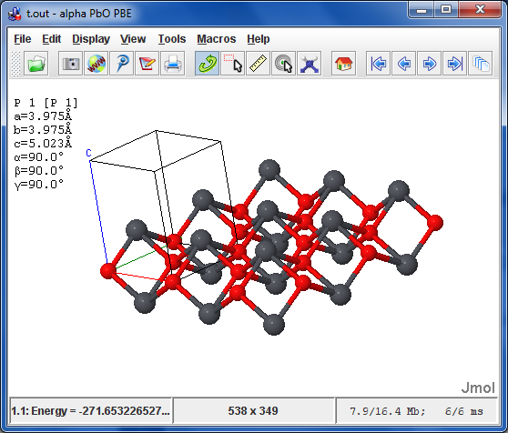
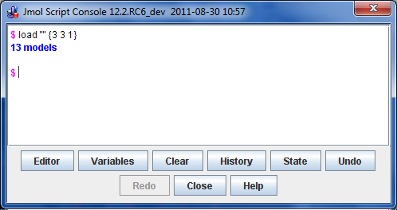
General Introduction to Jmol
Configurations:
Application

Slide 8
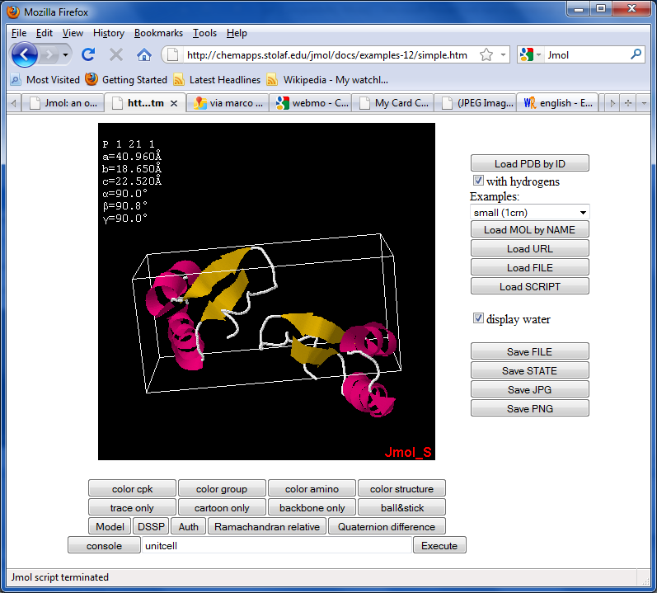
General Introduction to Jmol
Configurations:
Java Applet
easily added
highly customizable
highly interactive
highly modular
signed or unsigned
in 20 languages

Slide 9
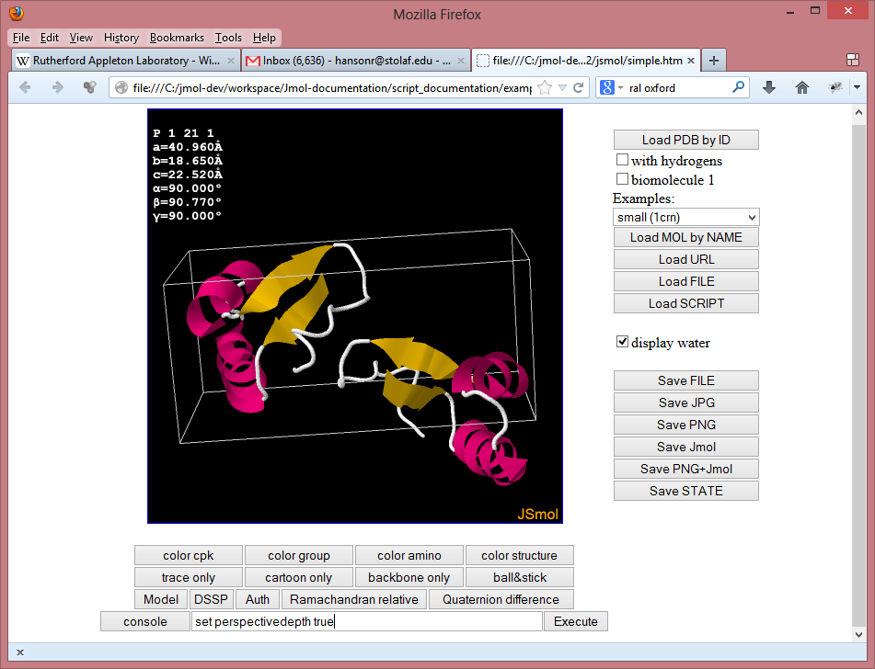
General Introduction to Jmol
Configurations:
JavaScript App
identical to Java
works in all popular browsers, including
Safari for the iPad, android phones, etc.
somewhat slower than Java

Slide 10
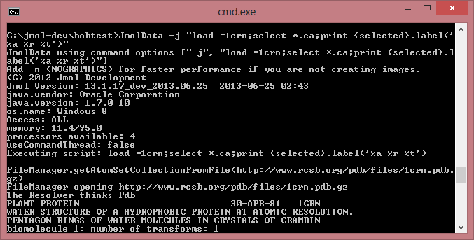
General Introduction to Jmol
Configurations:
Command-line Java application
server-side app
can run
“headless”
automated
workflow
.

Slide 11
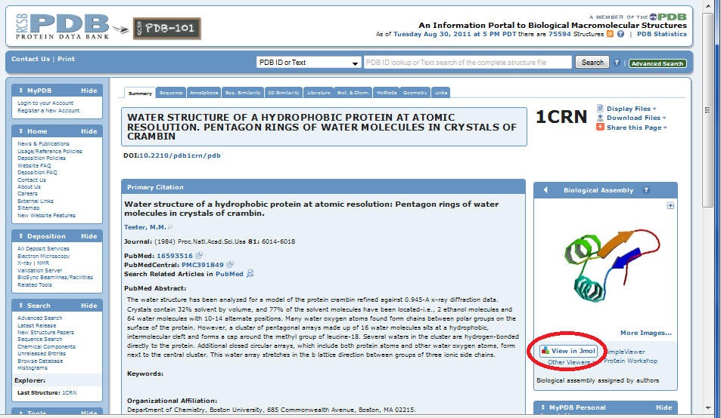
Jmol Examples from the Web
http://www.rcsb.org

Slide 12
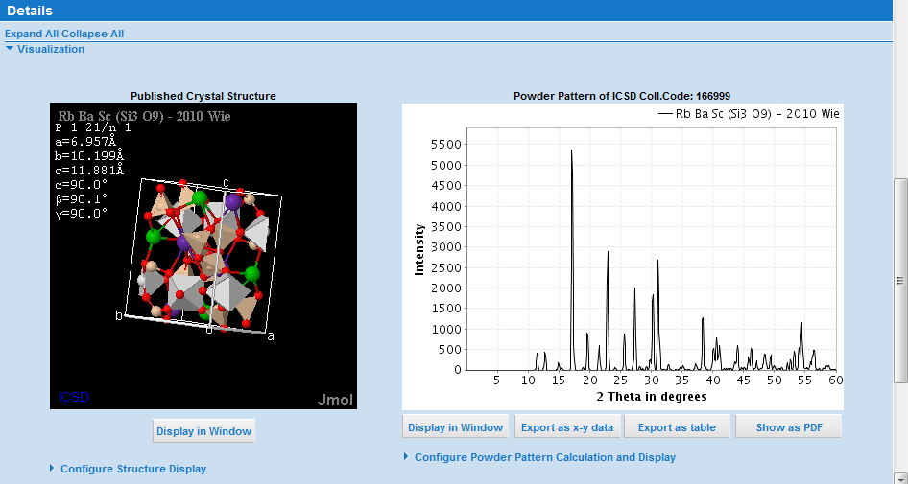
Jmol Examples from the Web
http://www.fiz-karlsruhe.de/icsd_web.html

Slide 13
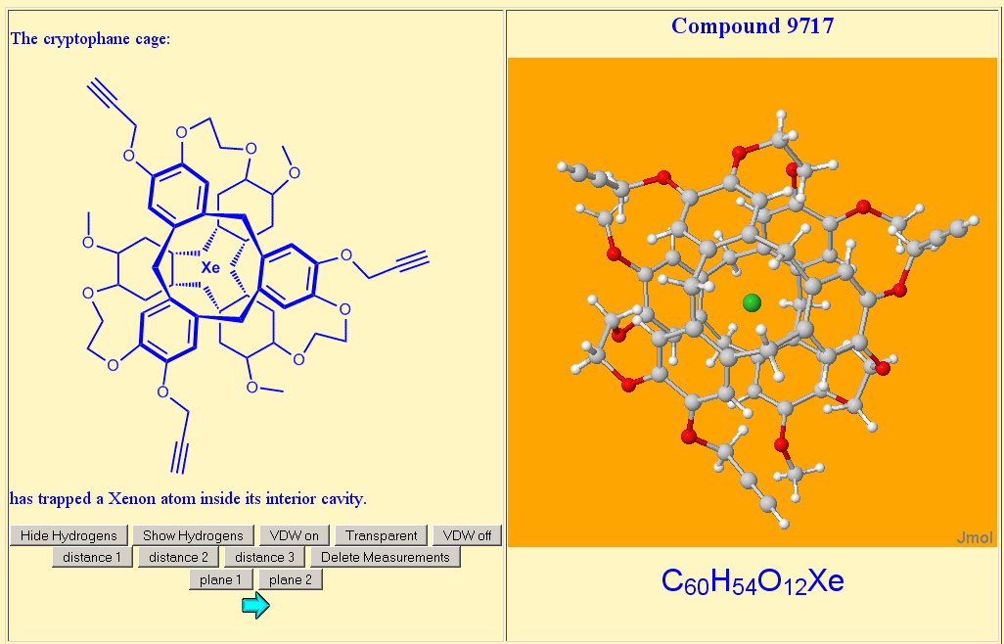
Jmol Examples from the Web
http://macxray.chem.upenn.edu

Slide 14
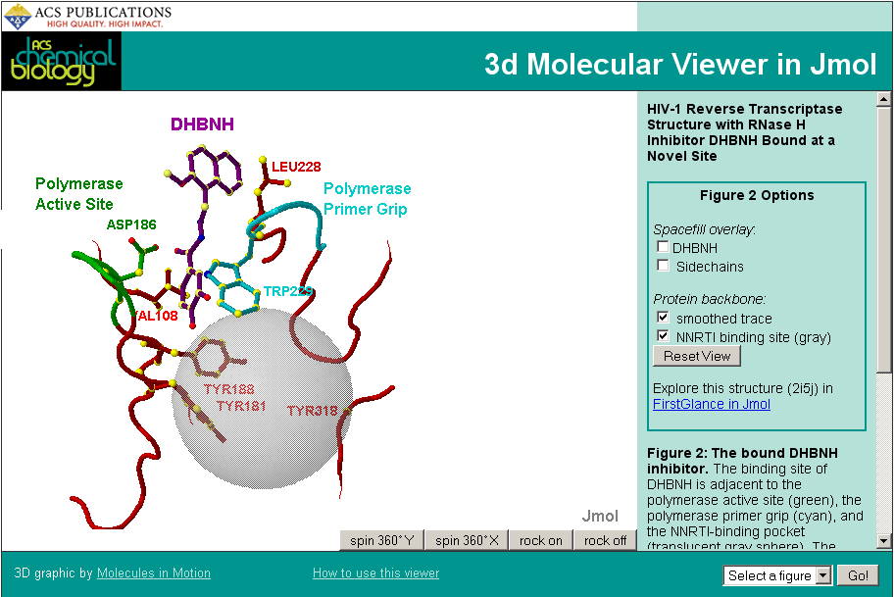
Frieda Reichsman, http://pubs.acs.org/doi/media/10.1021/cb600303y/figure2.htm

Slide 15
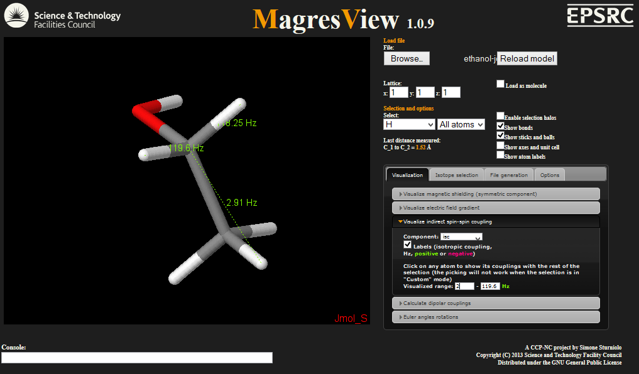
.
Simone Sturniolo, U. of Oxford, http://ccpforge.cse.rl.ac.uk/gf/project/magresview/wiki

Slide 16
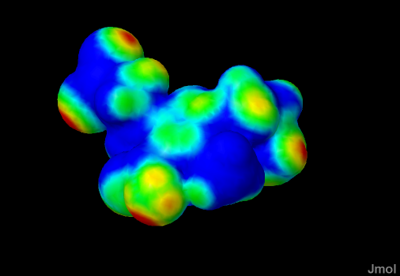
Recent Additions to Jmol
contact {ligand} SURFACE

Slide 17
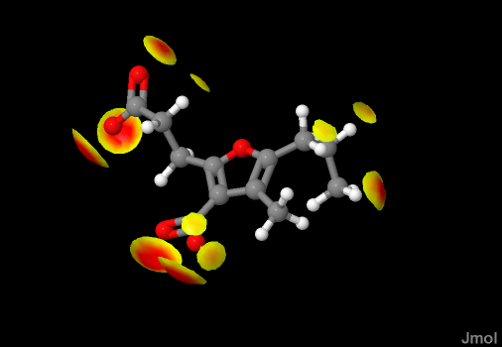
Recent Additions to Jmol
contact {ligand} TRIM

Slide 18
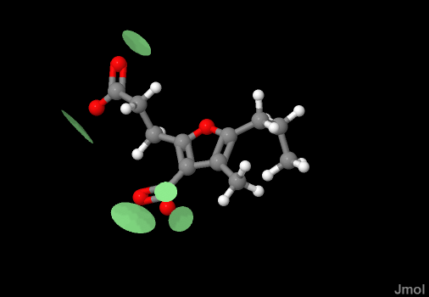
Recent Additions to Jmol
contact {ligand} HBOND

Slide 19
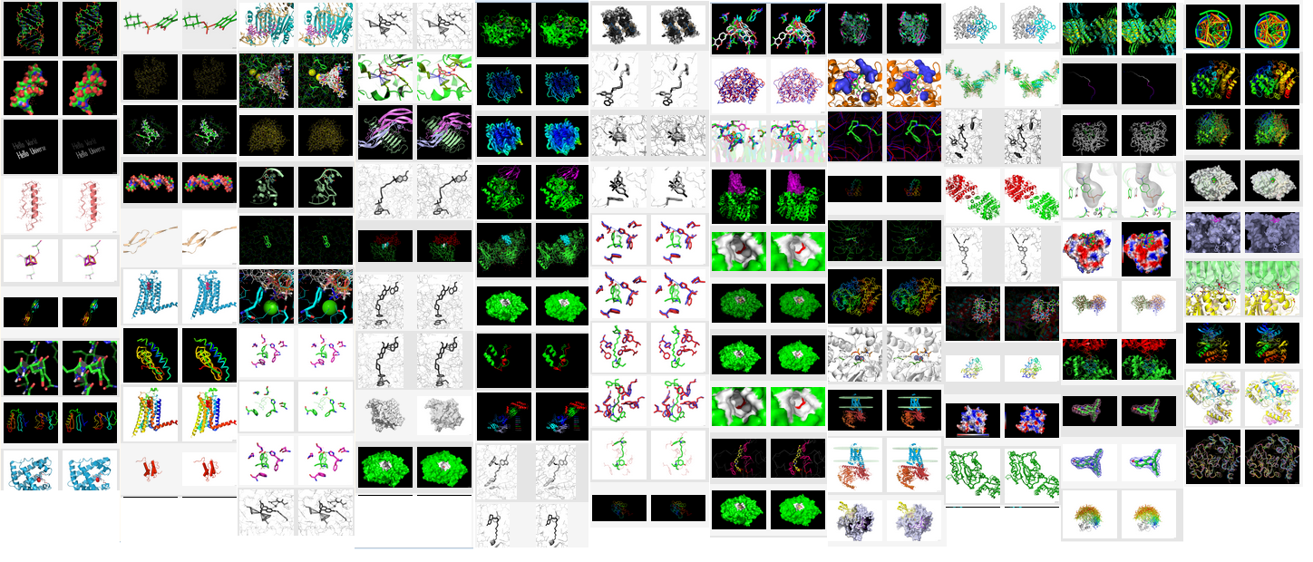
Recent Additions to Jmol
PyMOL session file reader
Jaim Prilusky http://ispcsrv.weizmann.ac.il/a2jmolb/browse

Slide 20
The Problem – Java Availability
During the summer of 2012 it became apparent that Java applets were no longer suitable for general web use.
Most notably, a series of security concerns surrounding Java applets during the fall and early winter of 2012 resulted in an announcement on Jan. 10, 2013, by the U.S. Department of Homeland Security with this suggestion:
Disable Java in web browsers
This and previous Java vulnerabilities have been widely targeted by attackers, and new Java vulnerabilities are likely to be discovered. To defend against this and future Java vulnerabilities, consider disabling Java in web browsers until adequate updates are available. As with any software, unnecessary features should be disabled or removed as appropriate for your environment.

Slide 21
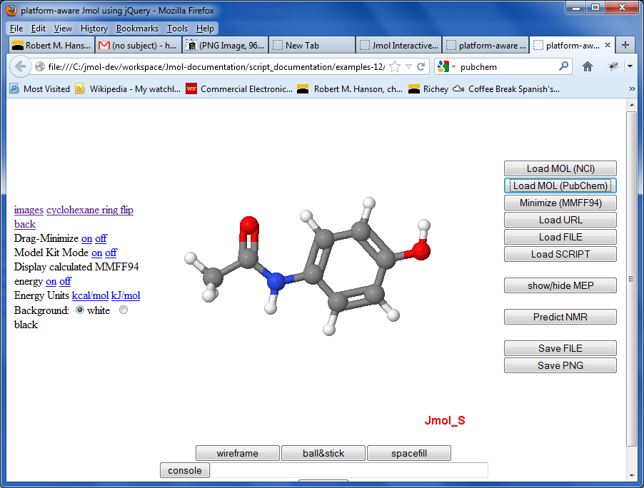
The Solution -- JSmol
Uses jQuery
Works with JSME
Rendering identical to the Java version
WebGL capability unnecessary
Works on iPad, iPhone
Allows all work still in Java; 2-min compile to JS
http://chemapps.stolaf.edu/jmol/jsmol/simple2.htm

Slide 22
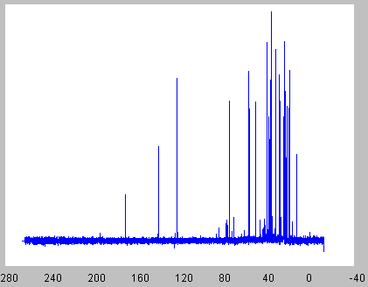
JSpecView
written by Bob Lancashire (U. West Indies, Mona)
released in 2006
handles several file types, particularly JCAMP-DX format
IR/Raman, 1D/2D-NMR, GC, MS, GC/MS, UV/VIS
folded into Jmol in 2012

Slide 23
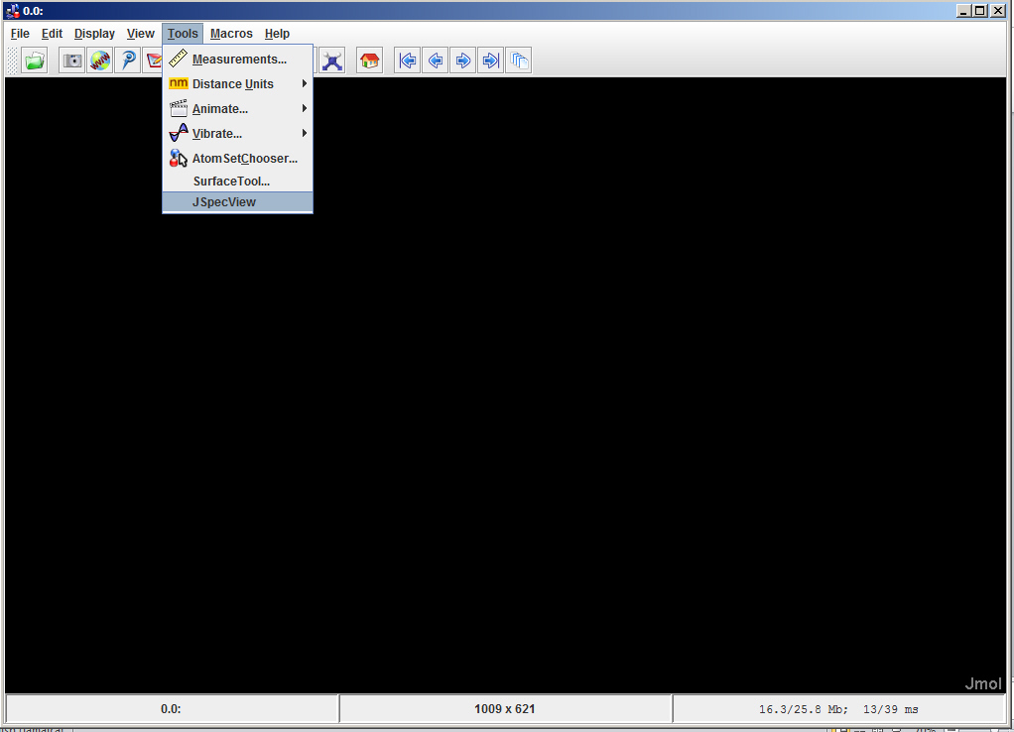
Jmol/JSpecView – Java Application
New JSpecView option under Jmol Tools menu

Slide 24
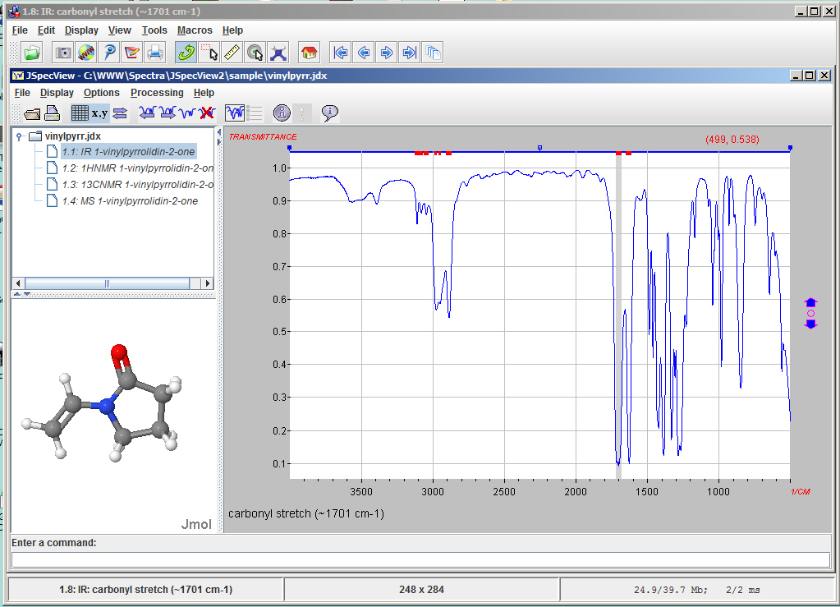
Jmol Application showing JSpecView as a tool - IR
Selecting an annotated peak will load an IR vibrational mode display in Jmol

Slide 25
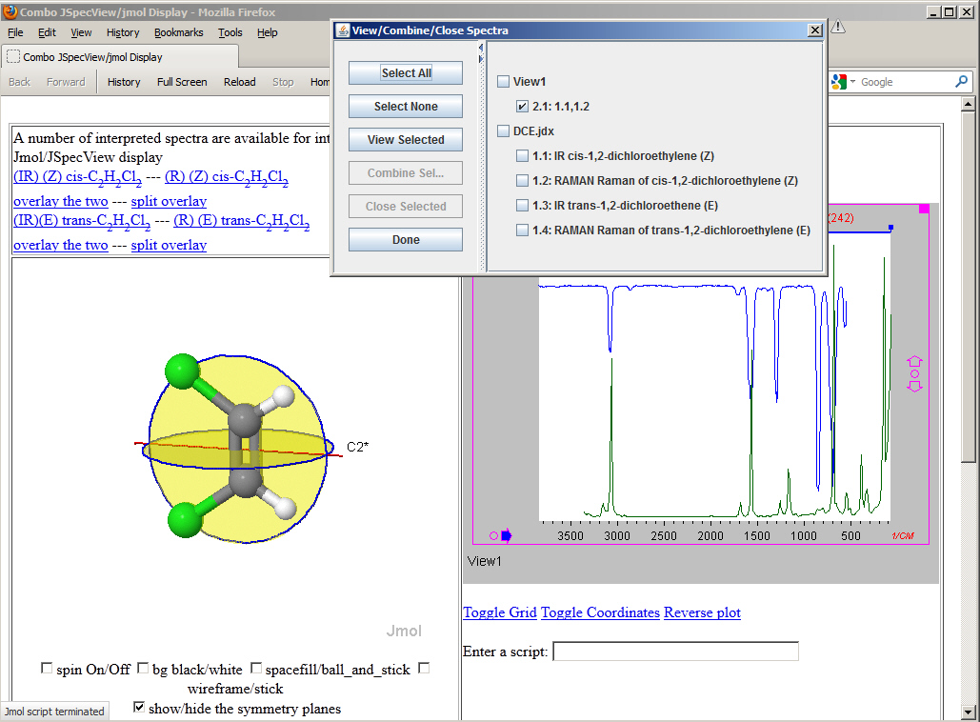
Jmol/JSpecView Applets for IR and Raman

Slide 26
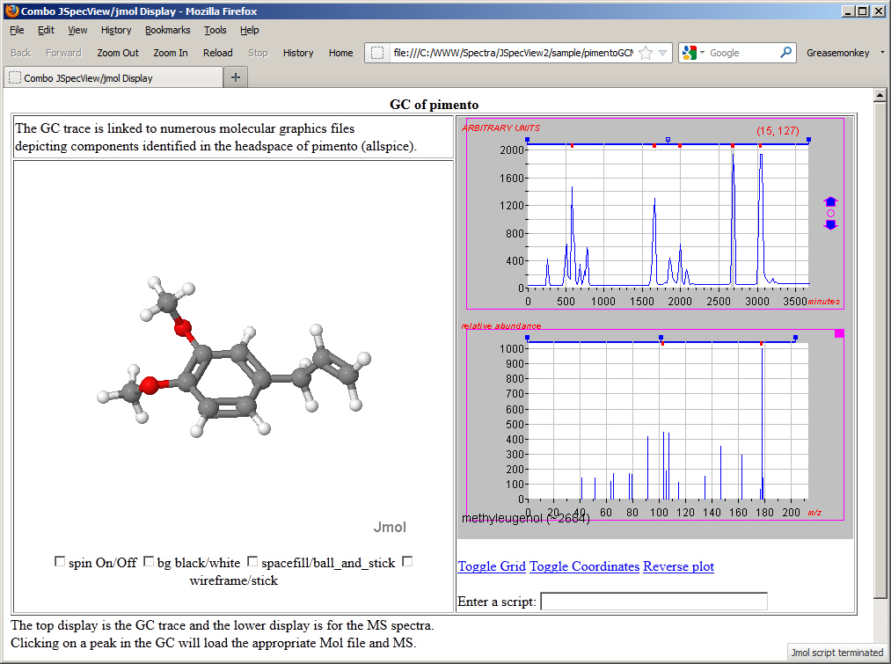
Jmol/JSpecView Applets for GCMS

Slide 27
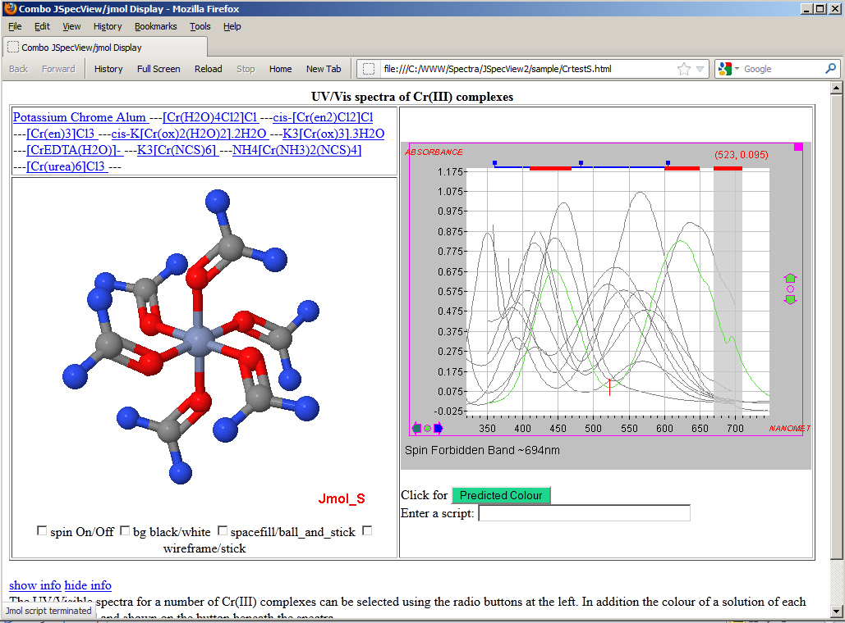
Jmol/JSpecView Applets for UV/Vis
.

Slide 28
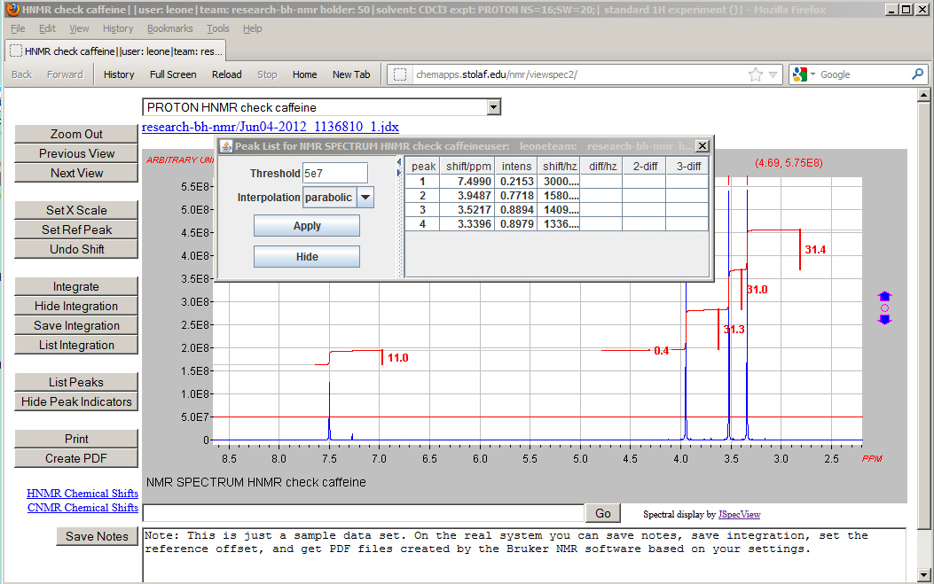
JSpecView Front-End for St. Olaf NMR Facility

Slide 29
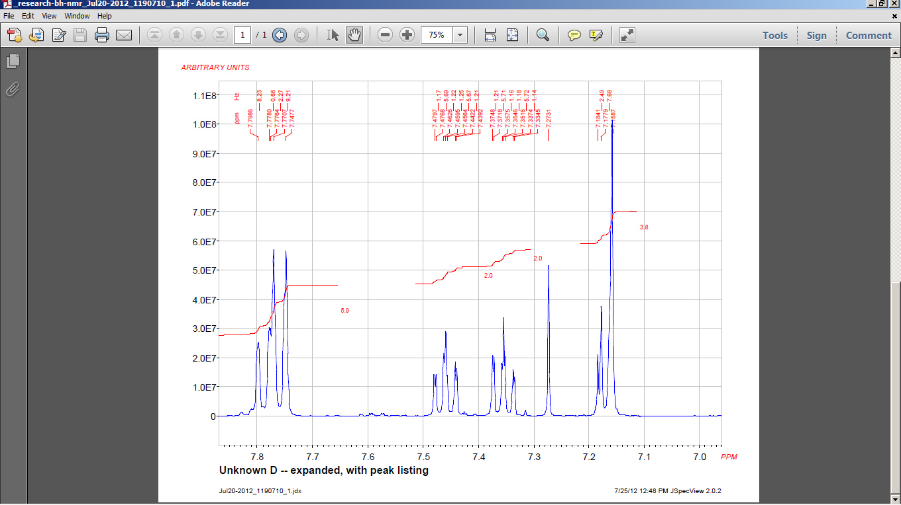
JSpecView – PDF Output

Slide 30
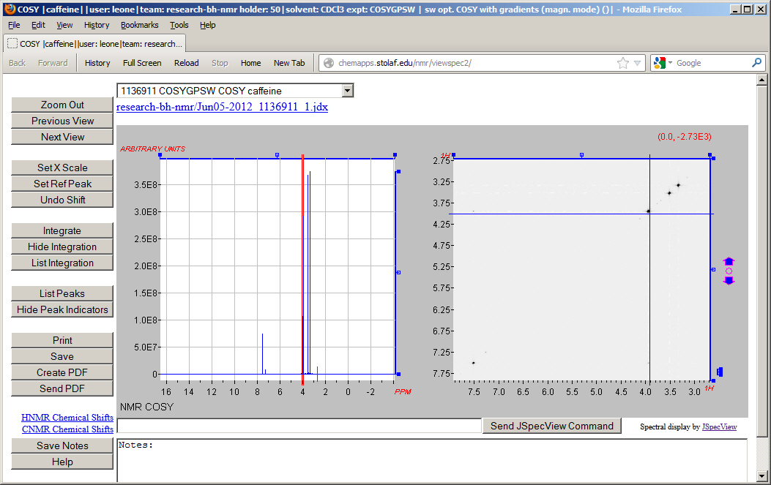
JSpecView 2D NMR

Slide 31
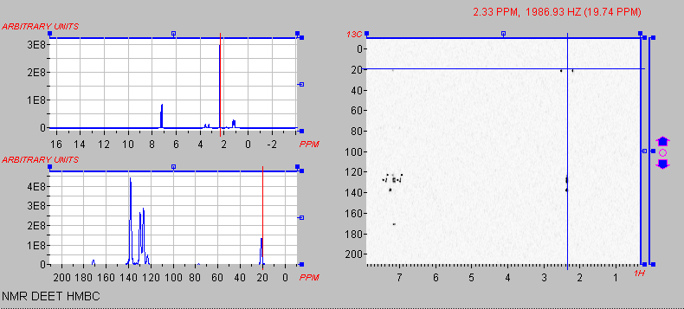
JSpecView 2D NMR

Slide 32
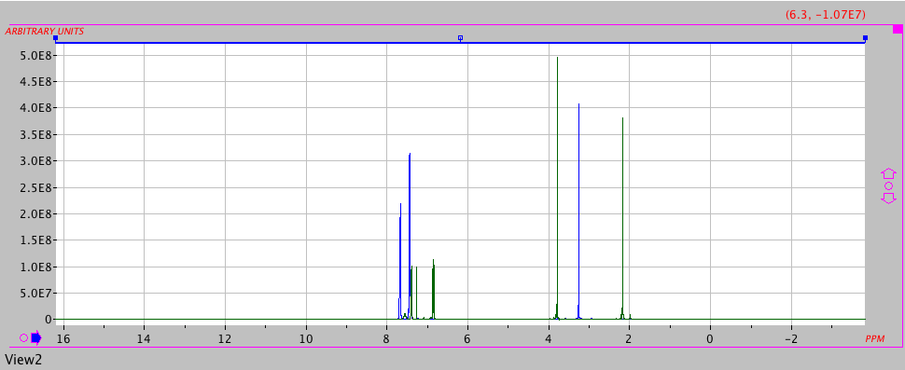
JSpecView for Spectral Comparison

Slide 33
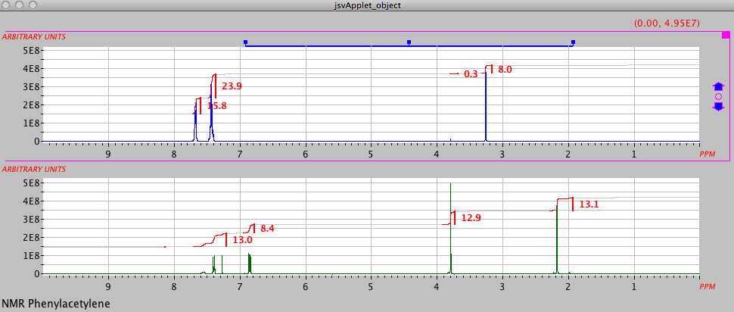
JSpecView for Spectral Comparison
… and, as of yesterday…

Slide 34
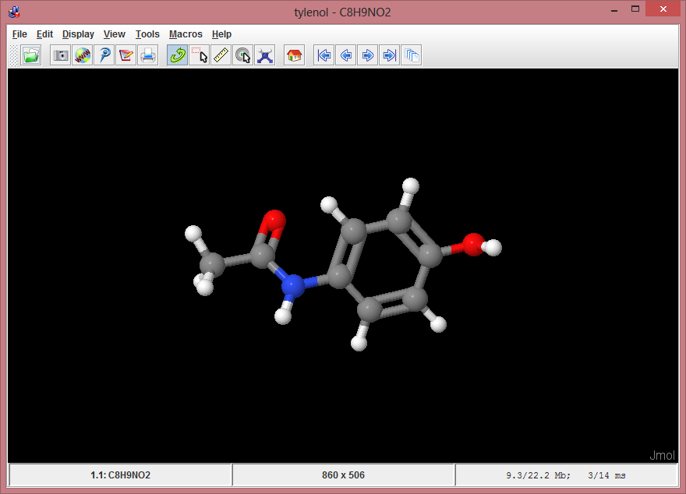
Jmol/JSpecView Interface to EPFL:
Easy Predicted NMR/Structure Correlation
load $tylenol

Slide 35
Jmol/JSpecView Interface to EPFL:
Easy Predicted NMR/Structure Correlation
load $tylenol
Utilizes the chemical identify resolver service at NCI/CADD
http://cactus.nci.nih.gov/
Implements CACTVS and OPSIN
Accepts names, generic IUPAC nomenclature, SMILES, CAS numbers,
InChI, etc.

Slide 36
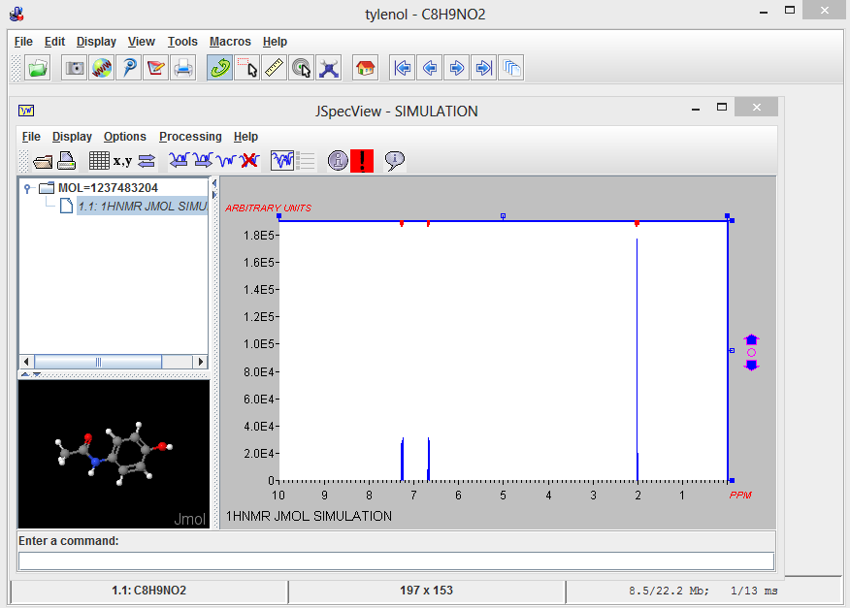
Jmol/JSpecView Interface to EPFL:
Easy Predicted NMR/Structure Correlation
load $tylenol; show NMR

Slide 37
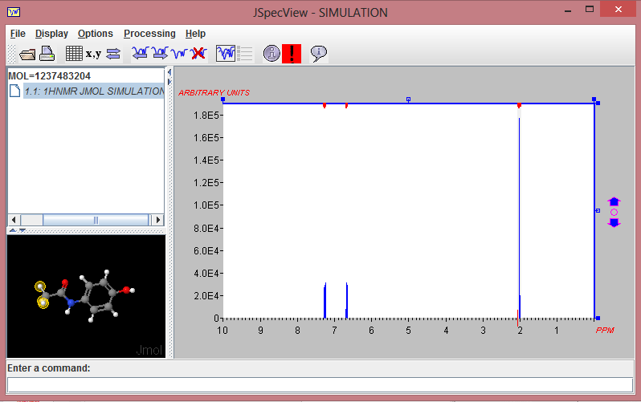
Jmol/JSpecView Interface to EPFL:
Easy Predicted NMR/Structure Correlation

Slide 38
Jmol/JSpecView Interface to EPFL:
Easy Predicted NMR/Structure Correlation
Jmol can load 3D models based on chemical names
http://cactus.nci.nih.gov/chemical/structure/tylenol/file?format=sdf&get3d=True
Jmol can also export MOL files
write tylenol.mol
C8H9NO2
APtclcactv08291319533D 0 0.00000 0.00000
20 20 0 0 0 0 0 0 0 0999 V2000
0.2055 0.8303 0.3823 C 0 0 0 0 0 0 0 0 0 0 0 0
0.6906 -1.4657 -0.1422 C 0 0 0 0 0 0 0 0 0 0 0 0
1.5485 1.1359 0.2829 C 0 0 0 0 0 0 0 0 0 0 0 0
2.0332 -1.1585 -0.2418 C 0 0 0 0 0 0 0 0 0 0 0 0
-3.9799 -0.1617 0.1295 C 0 0 0 0 0 0 0 0 0 0 0 0
4.2731 0.3568 0.7047 H 0 0 0 0 0 0 0 0 0 0 0 0
-1.8656 -1.6522 0.6012 H 0 0 0 0 0 0 0 0 0 0 0 0
-0.2273 -0.4718 0.1700 C 0 0 0 0 0 0 0 0 0 0 0 0
...

Slide 39
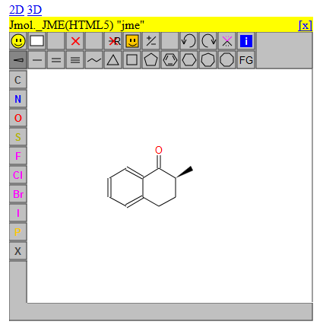
Jmol/JSpecView Interface to EPFL:
Easy Predicted NMR/Structure Correlation
…Jmol can also translate JME/JSME drawings to 3D

Slide 40
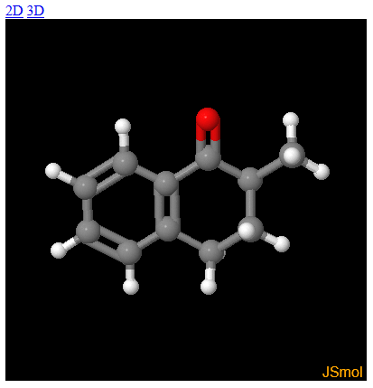
Jmol/JSpecView Interface to EPFL:
Easy Predicted NMR/Structure Correlation
…Jmol can also translate JME/JSME drawings to 3D

Slide 41
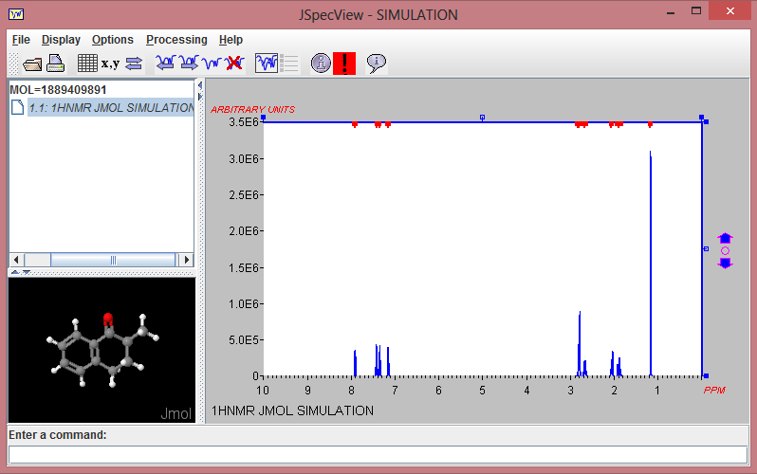
Jmol/JSpecView Interface to EPFL:
Easy Predicted NMR/Structure Correlation
… and then generate correlated 1H-NMR spectra

Slide 42
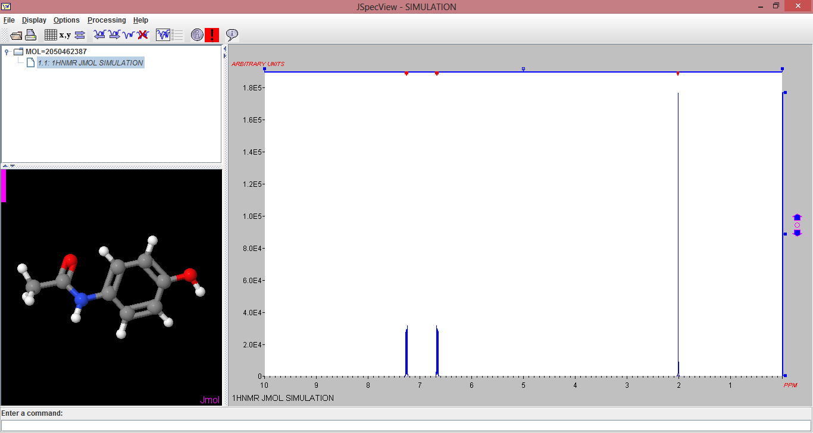
Jmol/JSpecView Interface to EPFL:
Easy Predicted NMR/Structure Correlation

Slide 43
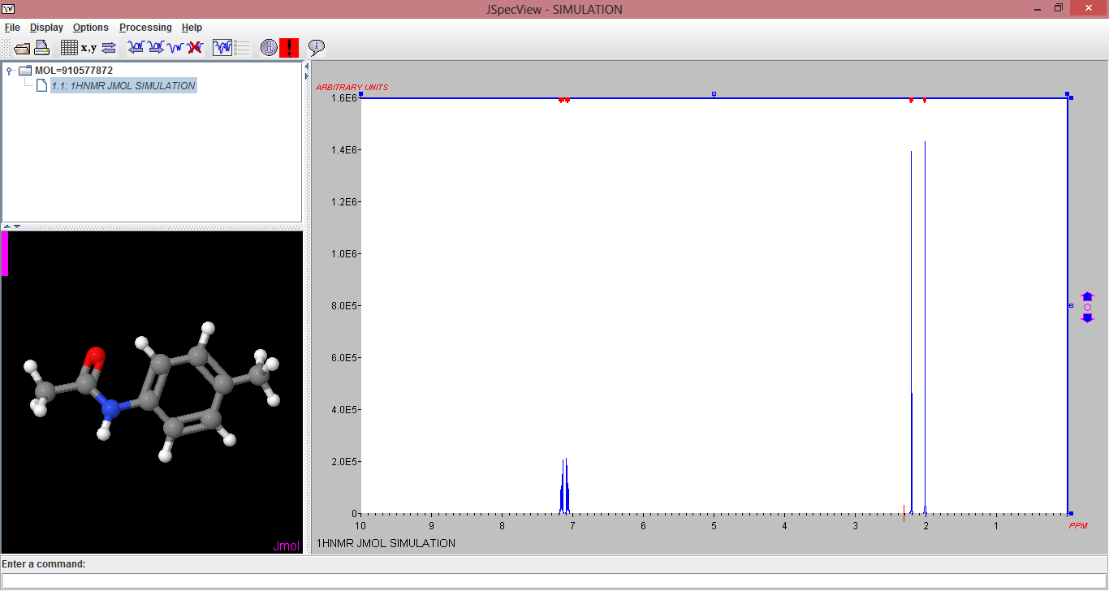
Jmol/JSpecView Interface to EPFL:
Easy Predicted NMR/Structure Correlation

Slide 44
Predicted NMR/Structure Correlation
Method Outline
.

Slide 45
Jcamp-MOL Proposal
Single JCAMP file includes
3D model structure
Assignments
Spectral data
Used for communication between Jmol and JSpecView.
Allows any number of blocks of independent data of many types.

Slide 46
Jcamp-MOL Proposal
##TITLE= Compound file, contains several data records
##JCAMP-DX= 5.0
##DATA TYPE= LINK
##BLOCKS=4
##ORIGIN= Department of Chemistry, UWI, JAMAICA
##OWNER= public domain
header block

Slide 47
Jcamp-MOL Proposal
##TITLE= Compound file, contains several data records
##JCAMP-DX= 5.0
##DATA TYPE= LINK
##BLOCKS=4
##ORIGIN= Department of Chemistry, UWI, JAMAICA
##OWNER= public domain
##TITLE= acetophenone
##JCAMP-DX= 4.24 $$ ISAS JCAMP-DX check program V1.1/a
##DATA TYPE= INFRARED SPECTRUM
##BLOCK_ID=1
…
##$MODELS=
<Models>
<ModelData id="acetophenone" type="MOL">
acetophenone
DSViewer 3D 0
…
</ModelData>
<ModelData id="1" type="XYZVIB" baseModel="acetophenone" vibrationScale=".1">
17
1 Energy: -1454.38826 Freq: 3199.35852
C -1.693100 0.007800 0.000000 -0.000980 0.000120 0.000000
</ModelData>
</Models>
…
header block
IR block
##$MODELS

Slide 48
Jcamp-MOL Proposal
##$PEAKS
Data section
##$SPEAKS=
<Peaks type="IR" xUnits="1/cm" yUnits="TRANSMITTANCE" >
<PeakData id="1" title="asymm stretch of aromatic CH group (~3100 cm-1)" peakShape="broad" model="1.1" xMax="3121" xMin="3092" yMax="1" yMin="0" />
< PeakData id="2" title="symm stretch of aromatic CH group (~3085 cm-1)" peakShape="broad" model="1.2" xMax="3091" xMin="3072" yMax="1" yMin="0" />
< PeakData id="3" title="asymm stretch of CH group (~3060 cm-1)" peakShape="broad" model="1.3" xMax="3071“…
</PeakData>
##DELTAX= .9643013
##XUNITS= 1/CM
##YUNITS= TRANSMITTANCE
##XFACTOR= .1221008
##YFACTOR= .2982387E-04
##FIRSTX= 499.5000
##LASTX= 4000.878
##MAXY= .9772386
##MINY= .9185180E-04
##NPOINTS= 3632
##FIRSTY= .6180727
##XYDATA=(X++(Y..Y))
4091B0724j08l27m60n84o98p20n44j74K85O54P97O78L83O4j65k80l17l18k91k12o9J13

Slide 49
Jcamp-MOL Proposal
##TITLE= acetophenone
##JCAMP-DX= 5.01 $$ JDXView vs 1
##DATA TYPE= NMR SPECTRUM
##DATA CLASS= XYDATA
##BLOCK_ID=2
##ORIGIN= Dept of Chemistry, UWI, Mona, JAMAICA
##OWNER= public domain
##SPECTROMETER/DATA SYSTEM= TECMAG APOLLO NTNMR
##$MODELS=
<Models>
<ModelData id="acetophenone" type="MOL">
Acetophenone
…
</ModelData>
</Models>
##$PEAKS=
<Peaks type="HNMR" xUnits="ppm" yUnits="arbitrary units" >
<PeakData id="1" title="methyl group ~2.6" peakShape="singlet" model="acetophenone" atoms="15,16,17" xMax="2.7" xMin="2.5" yMax="10000" yMin="0" />
<PeakData id="2" title="meta H's ~7.4" peakShape="multiplet" model="acetophenone" atoms="10,11" xMax="7.5" xMin="7.3" yMax="10000" yMin="0" />
…
</Peaks>
##.OBSERVE FREQUENCY= 199.584124
…
NMR block
.

Slide 50

Future Plans
http://www.drsunil.com/2012/10/initial-thoughts-on-thinking/

Slide 51

Next Task: JSpecView-JS
.

Slide 52
Acknowledgments
Luc Patiny – and family!
Robert Lancashire
Peter Ertl and Bruno Bienfait
St. Olaf College (sabbatical!)

